Slide 1

Sentiment Analysis of Amazon Reviews
Luke Therieau

Slide 2
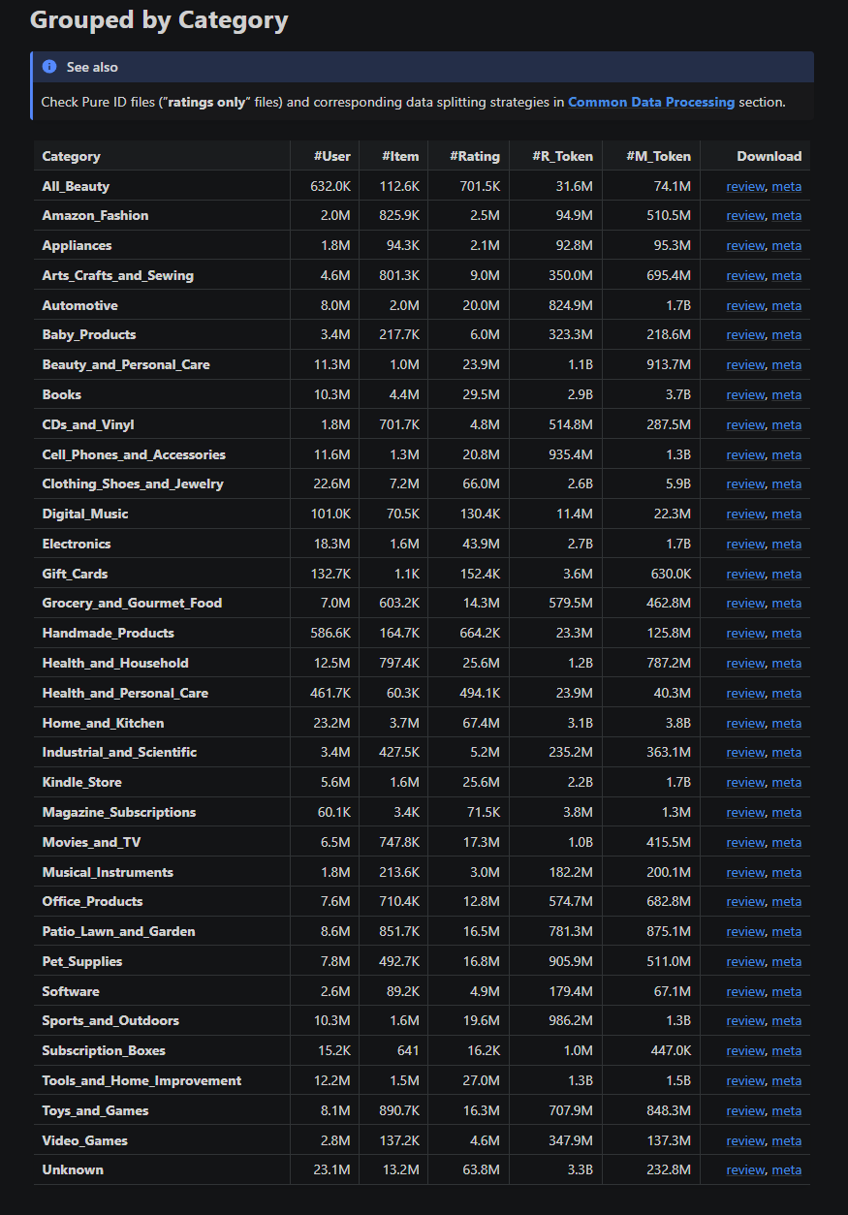
Data Source & Extraction
The data source for this project was Amazon reviews created between May 1996 and September 2023
Collected by students and faculty at the University of California San Diego
The datasets combined, represent a total of 571.54 million reviews and 34 distinct categories
This project’s focus was a subset of this data, consisting of the category of Video Games, which had 4.6M reviews
Created a multithreaded web scraper to extract the dataset
Data saved as feather files (.ftr), a portable file format that allows for fast and efficient read/write data operations

Slide 3
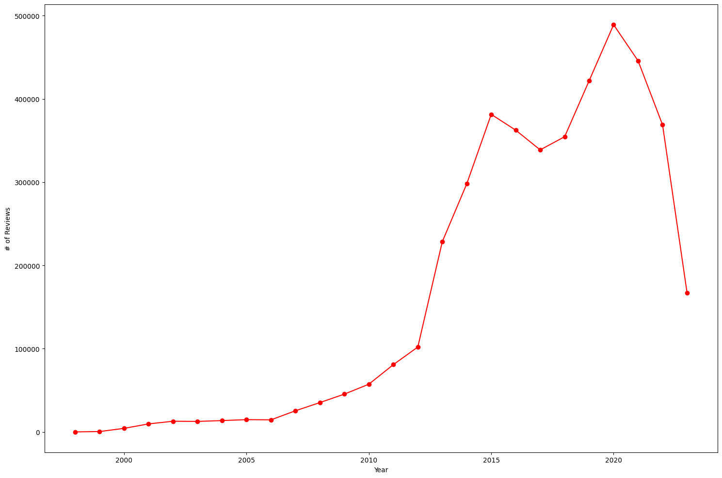
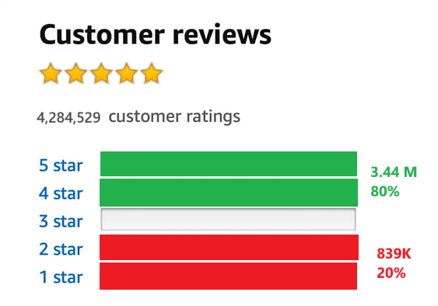
Data Exploration & Transformation
Majority of video game reviews that were collected were written between 2013 and 2021
Total size of dataset (minus neutral reviews) was 4.2 million
For sentiment scores:
  1- & 2-star reviews were labeled negative (0) reviews
    839 thousand reviews or about 20% of final dataset
  3-star reviews were excluded for analysis (neutral sentiment)
  4- & 5-star reviews were labeled positive (1) reviews
    3.44 million reviews or about 80% of final dataset

Slide 4
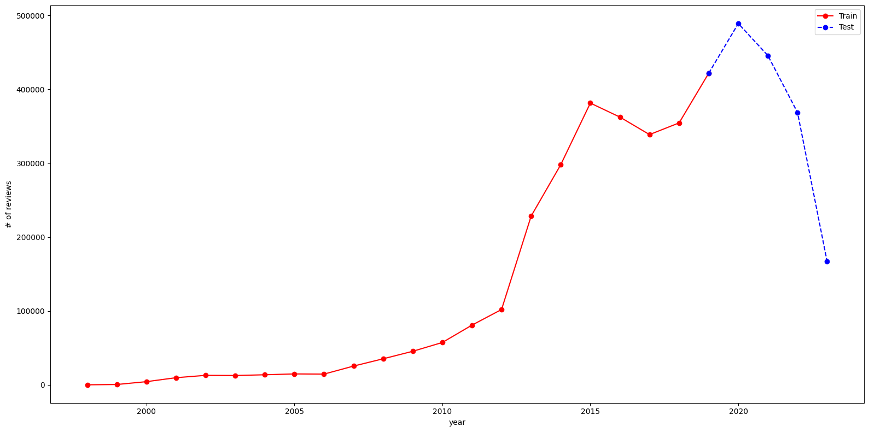
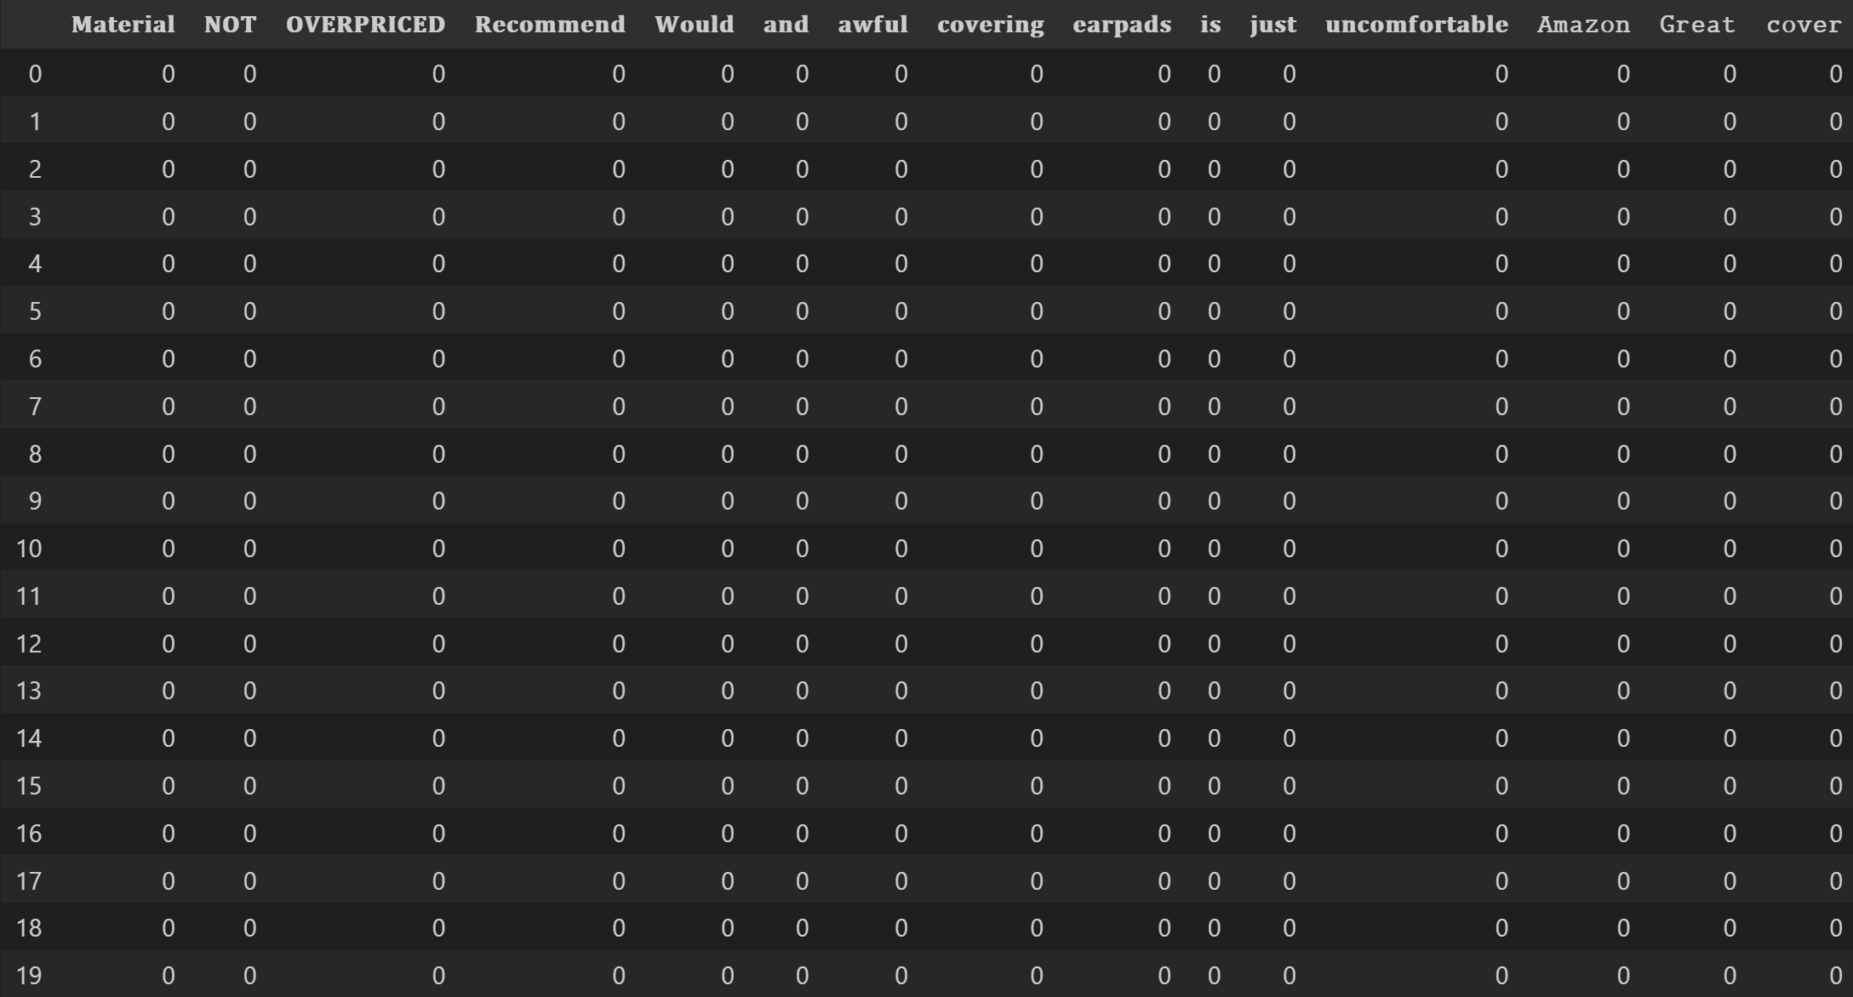
Preprocessing and Splitting Data
Training set is Amazon reviews created in 2019 or prior, which accounted for 65% of all data.
  Training set had 82% positive and 18% negative reviews
Testing set is Amazom reviews created in 2020 and after, which accounted for 35% of all data
I transformed and fitted the training features utilizing Count Vectorizer, which converts them into a sparse matrix containing word frequencies
Test features were transformed (not fitted) using the training count vector

Slide 5
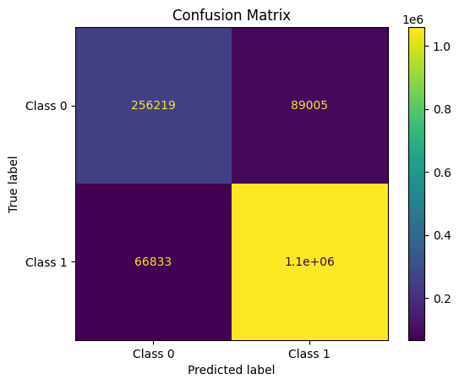
Model & Results
Multinomial Naïve Bayesian model was used for this project
MultinomialNB works best with discreate features like text frequencies, where It assumes word frequencies are independent of each other
MultinomialNB is popular in the use of sentiment analysis and other NLP tasks.
The model generated an accuracy of 89%
Got a true positive rate value of 94% and a true negative rate value of 74%

Slide 6
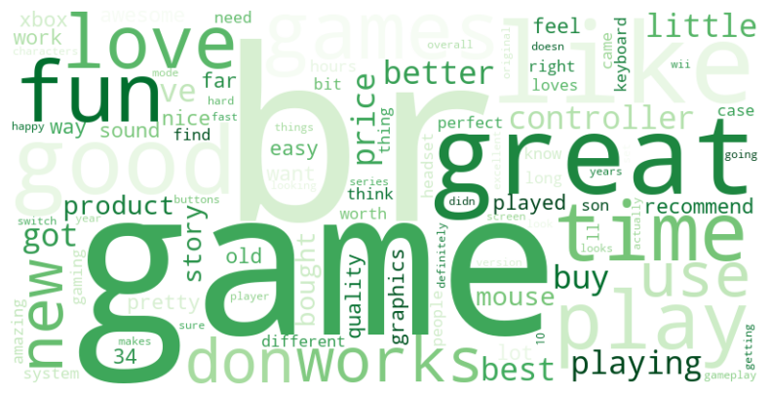
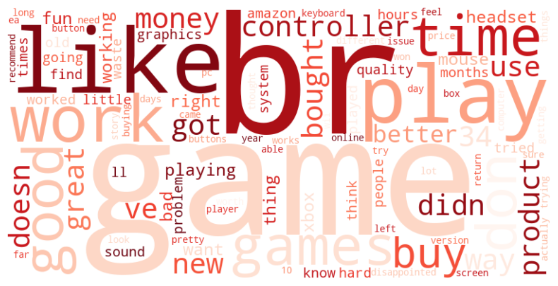
Important Features
Top 100 features for positive and negative reviews, based on log probability
Word clouds weighted based on these probability values

Slide 7
Data Source Citation
Bridging Language and Items for Retrieval and Recommendation
Yupeng Hou, Jiacheng Li, Zhankui He, An Yan, Xiusi Chen, Julian McAuley
arXiv
pdf

